Slide 1
Android Project folder Structure

Slide 2
Introduction
Android Studio is the official IDE (Integrated Development Environment) developed by the JetBrains community which is freely provided by Google for android app development.
After completing the setup of Android Architecture we can create an android application in the studio.
We need to create a new project for each sample application.

Slide 3
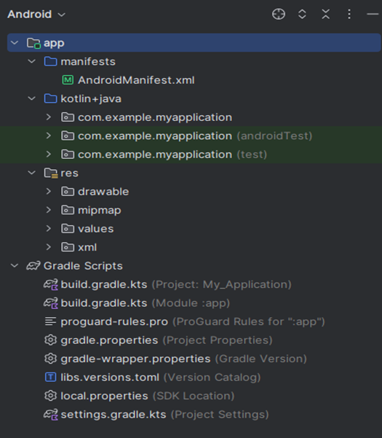
Folder Structure

Slide 4
Contd..
The android project contains different types of app modules, source code files, and resource files
Manifests Folder
Java + Kotlin Folder
res (Resources) Folder
Drawable Folder
Mipmap Folder
Values Folder
XML Folder
Gradle Scripts

Slide 5
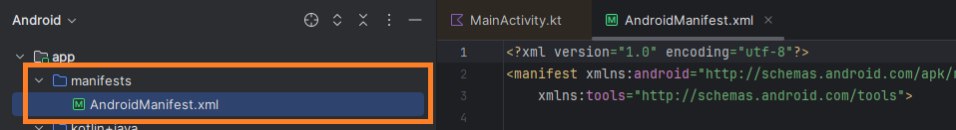
Manifests Folder
This contains AndroidManifest.xml for creating our android application.

Slide 6
Contd..
This file contains information about our application such as the Android version, metadata, states package for Kotlin file, and other application components.
It acts as an intermediator between android OS and our application.

Slide 7
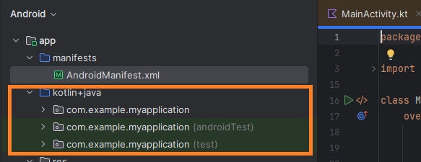
Java + Kotlin
The Java folder contains all the java and Kotlin source code (.java) files that we create during the app development, including other Test files.

Slide 8
Contd..
If we create any new project using Kotlin, by default the class file MainActivity.kt file will create automatically under the package name “com.example.applicationname”.

Slide 9
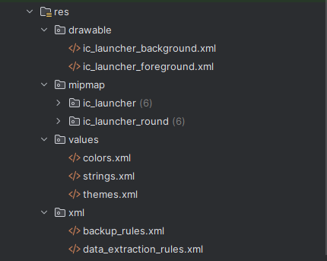
Resource (res)
The resource folder is the most important folder because it contains all the non-code sources like images, XML layouts, and UI strings for our android application.

Slide 10
Contd..
res/drawable folder
It contains the different types of images used for the development of the application.
We need to add all the images in a drawable folder for the application development.

Slide 11
Contd..
res/mipmap folder
This folder contains launcher.xml files to define icons that are used to show on the home screen.

Slide 12
Contd..
It contains different density types of icons depending upon the size of the device such as hdpi, mdpi, xhdpi.
res/values folder
Values folder contains a number of XML files like strings, dimensions, colors, and style definitions.
One of the most important files is the strings.xml file which contains the resources.

Slide 13
Gradle Scripts folder
Gradle means automated build system and it contains a number of files that are used to define a build configuration that can be applied to all modules in our application.

Slide 14
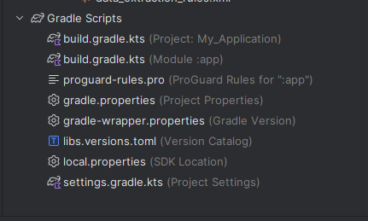
Contd..
In build.gradle (Project) there are buildscripts and in build.gradle (Module) plugins and implementations are used to build configurations that can be applied to all our application modules.

